Slide 1
WELCOME TO MY PRESENTATION
SUBJECT: Analog Communication
Topic :Blanking And Synchronizing Pulse

Slide 2
Submitted to:
MD. Imran Hossain
Assistant Professor
DEPT. of ICT
Comilla University
Submitted By:
Any Chowdhury
ID :11809028
DEPT. of ICT
Comilla University

Slide 3
Blanking Pulse
In television, “blanking” means going to black. As part of the video signal, blanking voltage is at the black level. Video voltage at the black level cuts off beam current in the picture tube to blank out light from the screen.
Why we use the blanking pulse?
The purpose of the blanking pulses is to make invisible the re-traces required in scanning. Horizontal blanking pulses at 15,750 Hz blank out the retrace from right to left for each line

Slide 4
Synchronizing Pulse
The synchronizing pulses are transmitted or stored along with the analog video signal for each line. These synchronizing pulses are then used to trigger the receiver’s circuitry make sure that the scene is sequenced properly on the screen.

Slide 5
Frequency of scanning, synchronizing and blacking pulse
The sync pulses and blanking pulses have the same frequency as that of scanning. The values are shown in the table given below.
No: | Particles | Frequency in Hz
1 | Horizontal Scanning Pulses | 15625
2 | Horizontal Sync Pulses | 15625
3 | Horizontal blanking Pulses | 15625
4 | Vertical Scanning Pulses | 50
5 | Vertical Sync Pulses | 50
6 | Vertical blanking Pulses | 50
7 | Equalizing Pulses | 31250

Slide 6
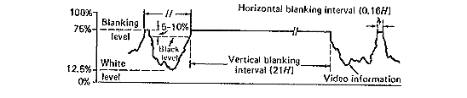
Horizontal and vertical blanking pulse:
Figure :Tv video waveform show information video information and horizontal and vertical blanking pulse at the end of Even Field

Slide 7
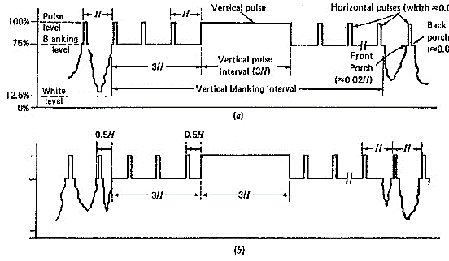
Horizontal and vertical sync pulse:
Figure :Tv video waveform showing horizontal and vertical sync pulse at the end of (a)Even field and (b)odd field

Slide 8
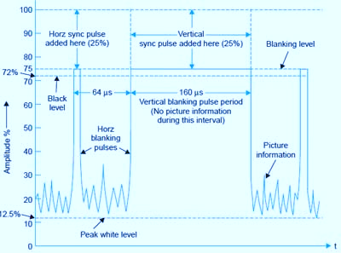

Horizontal and vertical blanking and syncronizing pulse together:

Slide 9
THANKS TO ALL

